Slide 1
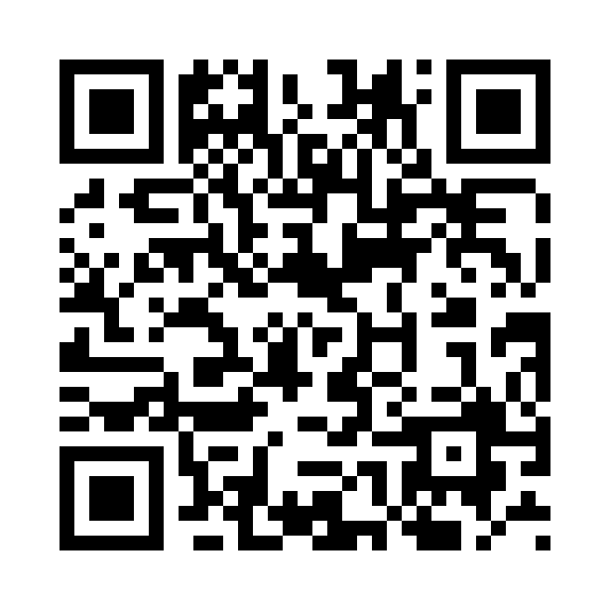
Timely Care | Mental Health + Well-Being
Talk Now
On-demand, mental and emotional support.
Scheduled Counseling
Appointments with diverse, credentialed, and licensed mental health professionals are available in less than 7 days.
Psychiatry
Students can access a licensed psychiatrist for a scheduled appointment in less than a week.
Digital Self-Care
Self-serve, well-being content designed to enhance a sense of calm, rest, and self-esteem both live and on-demand.
Health Coaching
Coaching to support lifestyle changes and developing healthy habits.
Faculty + Staff Support
A dedicated phone line for your to reach our care team for guidance in cases of student distress.
Download the TimelyCare app now!
Services are free to enrolled Mason students.
Notes:
TimelyCare is a virtual mental health and well-being platform available 24/7 for Mason students. Students can log in through URL provided or download the app on their phone. It is free for enrolled Mason students to access.
These are the services that will be provided through TimelyCare.
TalkNow is 24/7, on-demand emotional support to talk about anything, including anxiety, relationships, depression, and school-related stressors. Students can access this anywhere in the U.S. or overseas. They will not be able to choose their provider, but will meet with one that is available at that moment.
Scheduled Counseling: Choose the day, time, and a licensed mental health provider that works best for you. Students may choose from a list of licensed providers to schedule an appointment. They can schedule up to 12 appointments per academic year though it is case by case on if they need more support.
Health Coaching: Develop healthy lifestyle behaviors for nutrition, sleep habits, time management, and mindfulness.
Psychiatry: Appointments are available through referrals from CAPS and Student Health Services.
Self-Care Content: Visit the Explore page within TimelyCare for guided self-care content such as meditation and yoga.

Slide 2
AGENDA:
Poll
Review Quiz
Course Evaluations
Brainstorm
Journal 13
Thank you

Slide 3
Journal 13
Question 1:
Write your best advice for a future student in this class.
Question 2:
What is one thing you will remember from this class in the future – or how would you answer when someone asks “What did you learn in PSYC 100?”

